Slide 1

Customer Segmentation Using RFM Analysis and Unsupervised Clustering
A comparative study of K-Means, Hierarchical Clustering, and Gaussian Mixture Models on 49,661 e-commerce customers.
Lecturer: Mr. Him Soklong
Made by: Chang Tong
ID: CSE2024220035

Slide 2

CONTENTS
Context
Data Preparation
Data Exploring
Feature Engineering
Approach
Algorithm
Evaluation
Result
Final Outcome
Reflection

Slide 3
03/27
01 · CONTEXT
Problem Statement & Dataset
DATASET
The Problem
E-Commerce Customer for Behavior Analysis
E-commerce firms have vast transaction data, but lack the behavioral insights needed for targeted retention and marketing.
Source · Kaggle
250,000
49,661
The Goal
transaction records
unique customers
Segment ~50K customers using unsupervised RFM clustering to unlock actionable behavioral insights.
13
2020 – 2023
columns
Jan '20 → Sep '23
Why Feature Engineering
Data is transaction-level; behavioural signal only emerges once records are aggregated to the customer level.
KEY COLUMNS
Customer ID · Purchase Date · Product Category · Price · Quantity · Total Amount · Payment Method · Age · Returns · Gender · Churn

Slide 4
04/27
02 · PREPARATION
Data Cleaning Summary
01
No duplicates
Zero exact duplicate rows detected across all 250K records.
02
Missing 'Returns'
≈ 19% missing values imputed as zero (no return recorded).
03
Invalid transactions
Rows with zero or negative Quantity, Price, or Total Amount removed.
04
Redundant column
Dropped 'Age' (exact duplicate of 'Customer Age').
05
Result
Clean transaction-level table ready for customer aggregation.
Advanced Data Mining — Aug 4, 2026

Slide 5
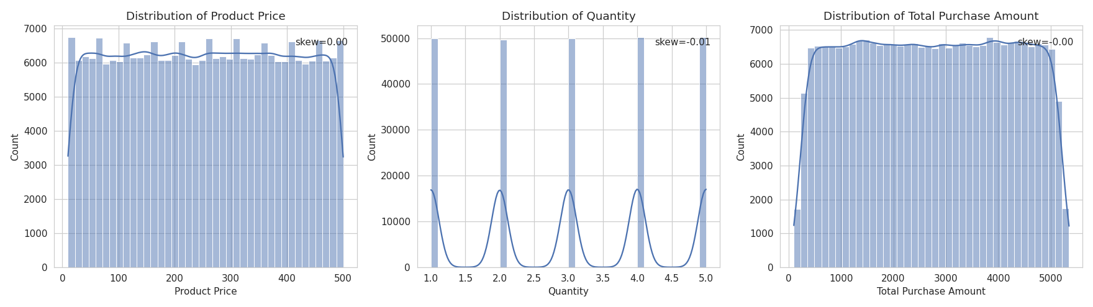
05/27
03 · EXPLORATION
EDA on Raw Transactions
Key Observations
Balanced payment mix
Symmetric distributions
Credit Card, PayPal, and Cash roughly balanced across transactions.
Price, Quantity, and Total Amount are near-symmetric (skew ≈ 0) — a strong hint of synthetic data.
Demographics
Balanced categories
Gender split ≈ 50/50 · average age ≈ 43.8 years.
Product categories split ~25% each: Electronics, Clothing, Home, Books.
Behavioural signals
Churn 20.1% · transaction-level return rate ≈ 50%.

Slide 6
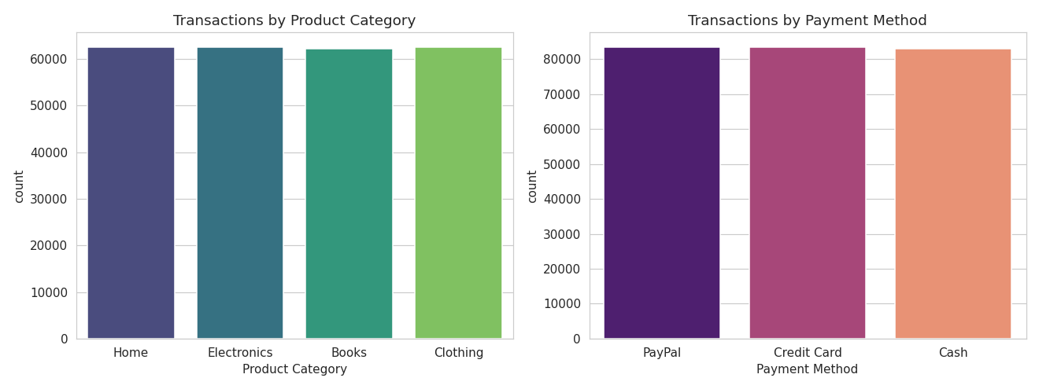
06/27
03 · EXPLORATION
EDA on Raw Transactions
Key Observations
Balanced payment mix
Symmetric distributions
Credit Card, PayPal, and Cash roughly balanced across transactions.
Price, Quantity, and Total Amount are near-symmetric (skew ≈ 0) — a strong hint of synthetic data.
Demographics
Balanced categories
Gender split ≈ 50/50 · average age ≈ 43.8 years.
Product categories split ~25% each: Electronics, Clothing, Home, Books.
Behavioural signals
Churn 20.1% · transaction-level return rate ≈ 50%.

Slide 7
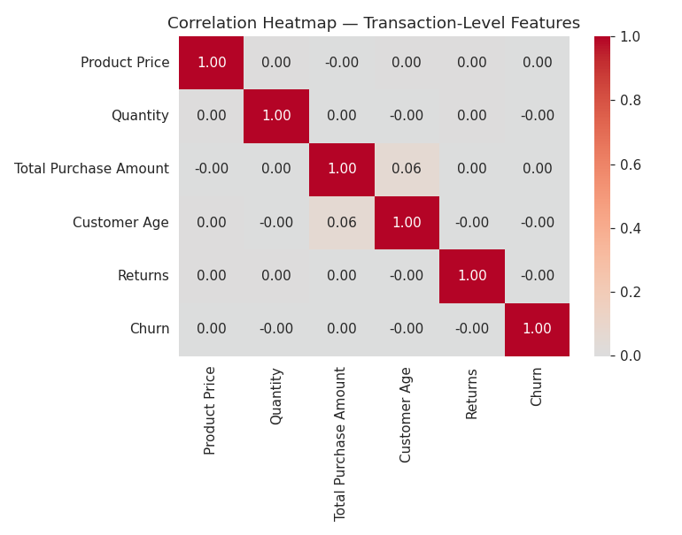
07/27
03 · EXPLORATION
Correlation Insights
Near-zero everywhere.
01
Weak numeric correlation
All pairwise correlations between Price, Quantity, Age, Returns, and Churn hover near zero at the transaction level.
02
Raw features aren't enough
Individual transaction features do not, on their own, reveal customer behaviour patterns.
03
Justifies aggregation
Motivates aggregation to customer-level RFM features to surface meaningful behavioural signal for clustering.

Slide 8


08/27
04 · FEATURE ENGINEERING
RFM Feature Engineering Method
Feature that used
Recency
Frequency (log)
Monetary (log)
AOV
Return Rate %
TRANSFORMATION PIPELINE
1
2
3
Aggregate → Customer
Log-transform skew
IQR outlier cap
4
Standardize (μ=0, σ=1)

Slide 9
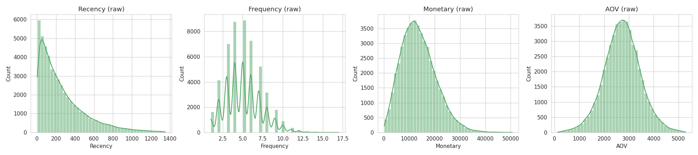
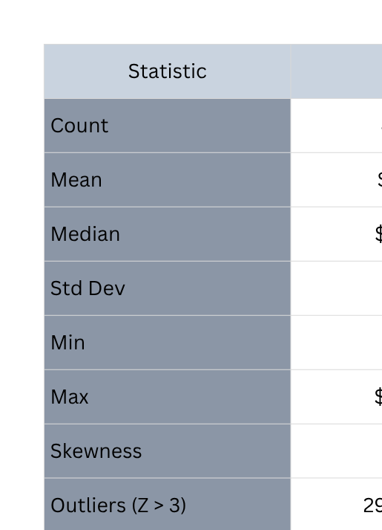
09/27
04 · FEATURE ENGINEERING
RFM Feature Engineering & Distributions
Advanced Data Mining — Aug 4, 2026

Slide 10
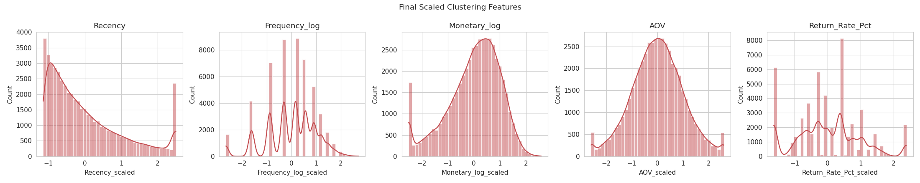
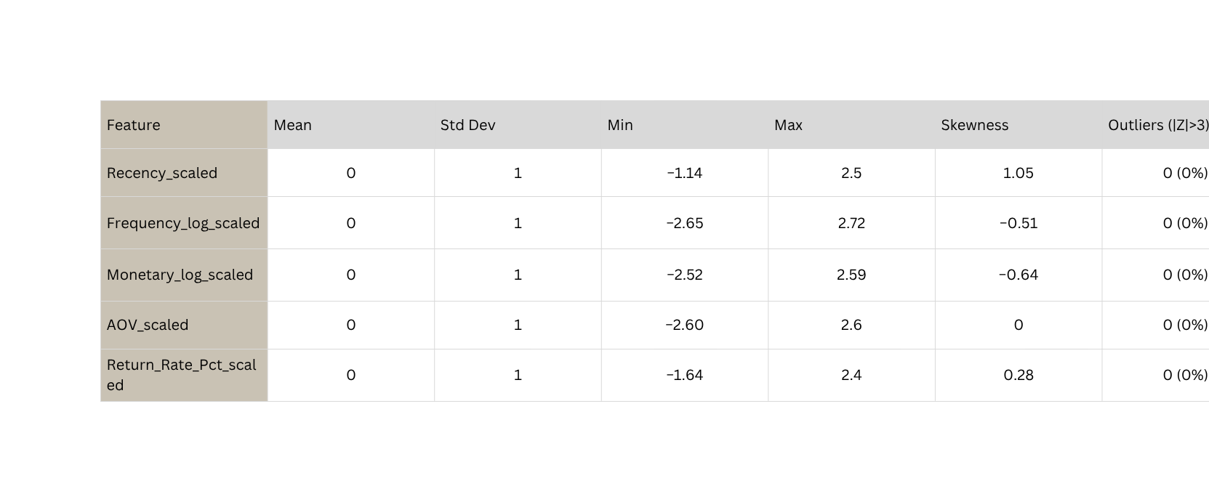
10/26
04 · FEATURE ENGINEERING
RFM Feature Engineering & Distributions

Slide 11

11/27
04 · FEATURE ENGINEERING
RFM Feature Engineering finding
Customer-Level Summary
Averages across 49,661 customers after feature engineering.
254 days
Avg Recency
5 orders
Avg Frequency
$13,720
Avg Monetary
$2,727
Avg AOV
40.6%
Avg Return Rate

Slide 12
12/27
05 · APPROACH
Clustering Feature Set & Approach
01
02
03
04
FEATURES Selected
PARADIGM
TUNING
PRIORITY
Recency · Frequency (log) · Monetary (log) · AOV · Return Rate %
Unsupervised — no ground-truth labels. Algorithms discover latent segments from behaviour alone.
Grid search across k, initialization, linkage, and covariance types. Consistent metrics across methods.
Balanced focus on scalability to ~50K and sampling 10k customers and interpretability of resulting personas.
All standardized.
07 / 14

Slide 13
13/27
06 · ALGORITHMS
Algorithms Selected & Rationales
ALGORITHM 01
ALGORITHM 02
ALGORITHM 03
K-Means
Hierarchical
GMM
Fast, scalable to the full 49,661 customers
Captures non-spherical clusters; no fixed k initially
Soft, probabilistic assignment
Industry-standard baseline for RFM segmentation
Models elliptical (non-isotropic) clusters
Useful for validating cluster count across methods
Tuned n_components = 2–8 · covariance types
Tuned k = 2–8 · init methods · n_init
Tuned k = 2–8 · linkage · distance metric
BEST CONFIGURATION
k = 4 · linkage = complete · metric = euclidean
BEST CONFIGURATION
BEST CONFIGURATION
k = 4 · init = random · n_init = 20
CAVEAT
n_components = 4 · covariance = tied
Ran on 4,000-customer sample due to O(n²) complexity.
08 / 14
Advanced Data Mining — Aug 4, 2026

Slide 14
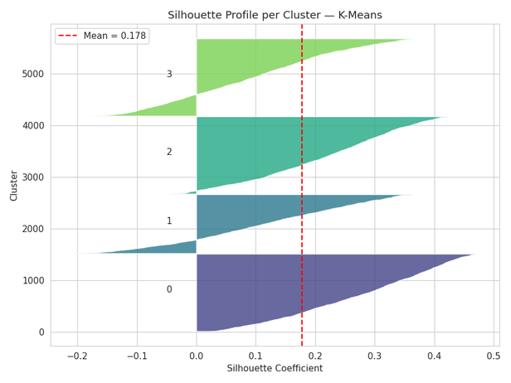
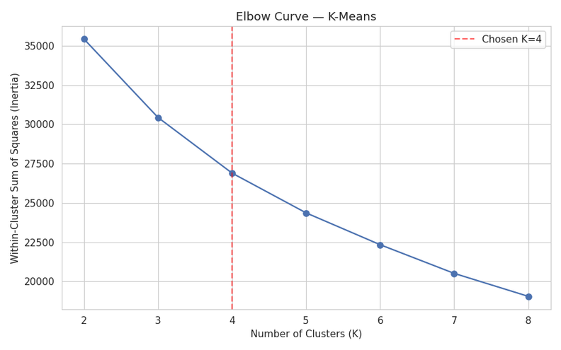
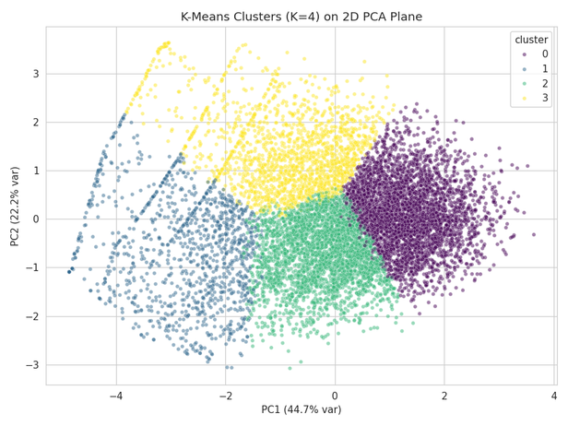
14/27
06 · ALGORITHMS
Algorithms Selected & Rationales
ALGORITHM 01
K-Means
Fast, scalable of 10k out of 50k customers
Industry-standard baseline for RFM segmentation
Tuned k = 2–8 · init methods · n_init
BEST CONFIGURATION
k = 4 · init = random · n_init = 20
08 / 14

Slide 15
15/27
06 · ALGORITHMS
Algorithms Selected & Rationales
Result and Interpretation
K=4 selected via Elbow curve (init=random, n_init=20).
Metrics: Silhouette = 0.247 | Davies-Bouldin = 1.4693| Calinski-Harabasz = 2868.2
Trade-off: K=2 had higher Silhouette (0.3054), but K=4 yields balanced, actionable personas.
Next Steps: K-Means’ spherical assumption struggles with irregular data, motivating tests with GMM and Hierarchical Clustering.
08 / 14

Slide 16
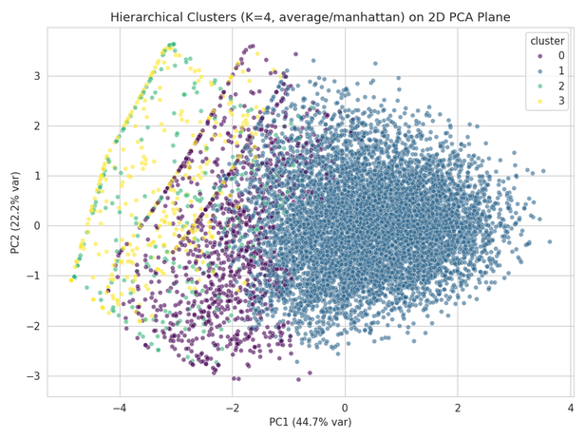
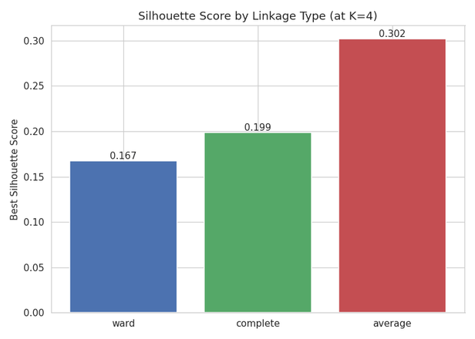
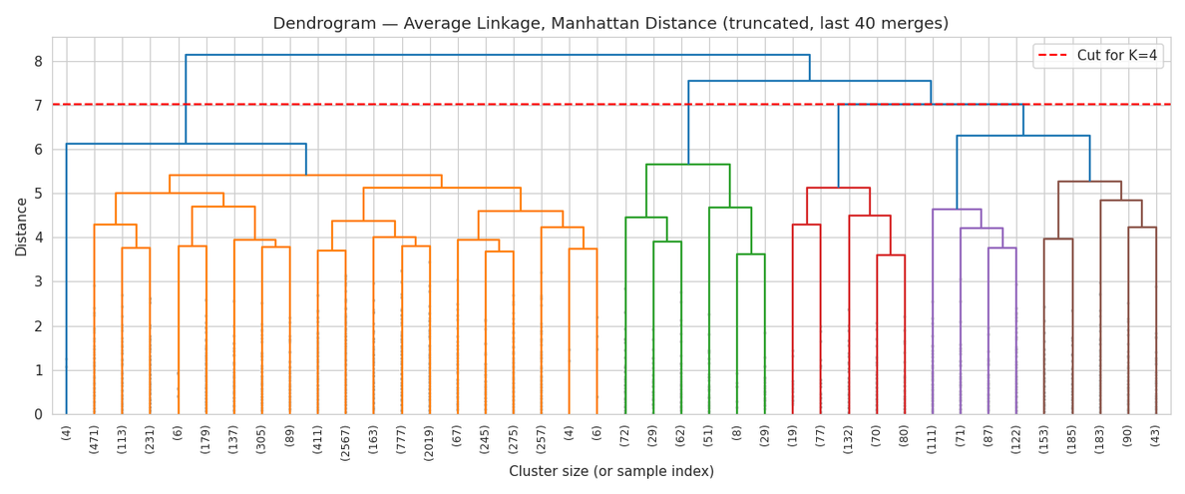
16/27
06 · ALGORITHMS
Algorithms Selected & Rationales
ALGORITHM 02
Hierarchical
Captures non-spherical clusters; no fixed k initially
Useful for validating cluster count across methods
Tuned k = 2–8 · linkage · distance metric
BEST CONFIGURATION
k = 4 · linkage = complete · metric = euclidean

Slide 17
17/27
06 · ALGORITHMS
Algorithms Selected & Rationales
Result and Interpretation
Best Setup: Complete linkage, Euclidean metric (K=4).
Metrics (Sample = 10000): Silhouette = 0.3016(Highest) | DB = 1.6219| CH = 1469.2
Win overall out of the data
Best when used with K=4

Slide 18
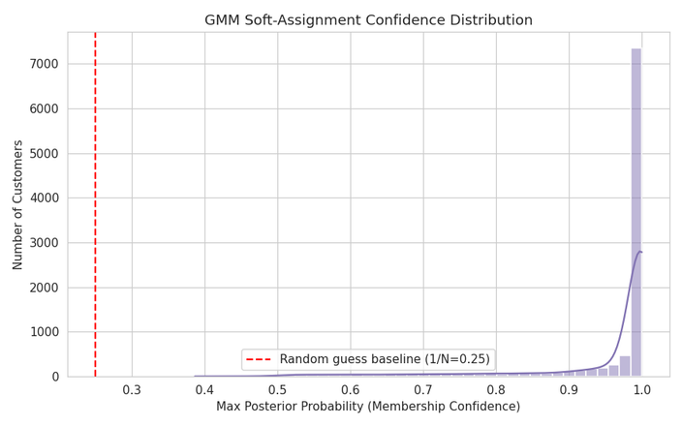
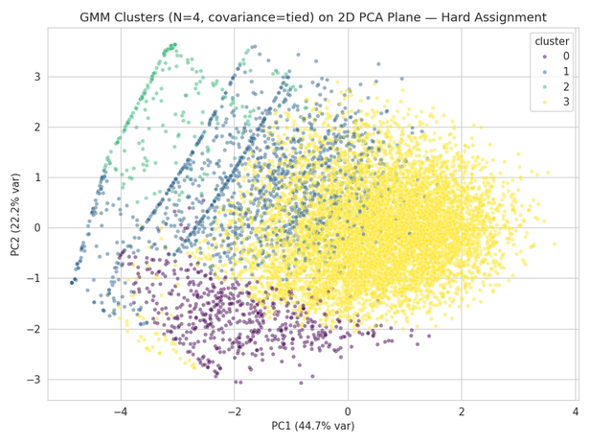
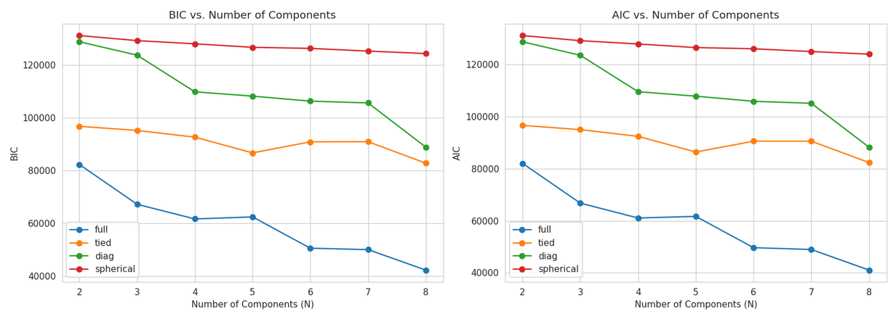
18/27
06 · ALGORITHMS
Algorithms Selected & Rationales
ALGORITHM 03
GMM
Soft, probabilistic assignment
Models elliptical (non-isotropic) clusters
Tuned n_components = 2–8 · covariance types
BEST CONFIGURATION
n_components = 4 · covariance = tied

Slide 19
19/27
06 · ALGORITHMS
Algorithms Selected & Rationales
Result and Interpretation
Best Setup: Tied covariance (K=4).
Metrics: Silhouette = 0.2694(Highest) | DB = 1.4685| CH = 750.32
Key Insight: Full covariance won BIC/AIC but dropped Silhouette to 0.159 (overlap). Statistical fit =/ neq best separation.
Takeaway: High posterior confidence (>95%) confirms distinct clusters; tied covariance balances flexibility and clean separation.

Slide 20
20/27
07 · EVALUATION
Clustering Evaluation Metrics
Silhouette
↑
Measures cluster cohesion vs. separation—the most interpretable geometric metric for clustering quality.
RANGE –1 to 1 · HIGHER IS BETTER
Davies-Bouldin
↓
Measures average similarity between nearest clusters—lower values indicate tight, well-separated groups.
RANGE ≥ 0 · LOWER IS BETTER
↑
Calinski-Harabasz
Ratio of between-cluster to within-cluster dispersion—rewards dense, well-separated partitions.
RANGE ≥ 0 · HIGHER IS BETTER
Advanced Data Mining — Aug 4, 2026

Slide 21
21/27
08 · RESULTS
Side-by-Side Performance
ALGORITHM
BEST PARAMETERS
SILHOUETTE ↑
DAVIES-BOULDIN ↓
CALINSKI-HARABASZ ↑
OUTCOME
K-Means
k=4 · random init · n_init=20
0.2060
1.4648
1438.2640
—
Hierarchical
k=4 · complete linkage · euclidean
0.2996
1.5969
761.0220
WINNER
GMM
n_components=4 · tied covariance
0.2627
1.4685
750.3216
—
KEY TAKEAWAYS
CONVERGENCE
Hierarchical claims the top Silhouette by a clear margin.
All three algorithms independently converge on k = 4.

Slide 22
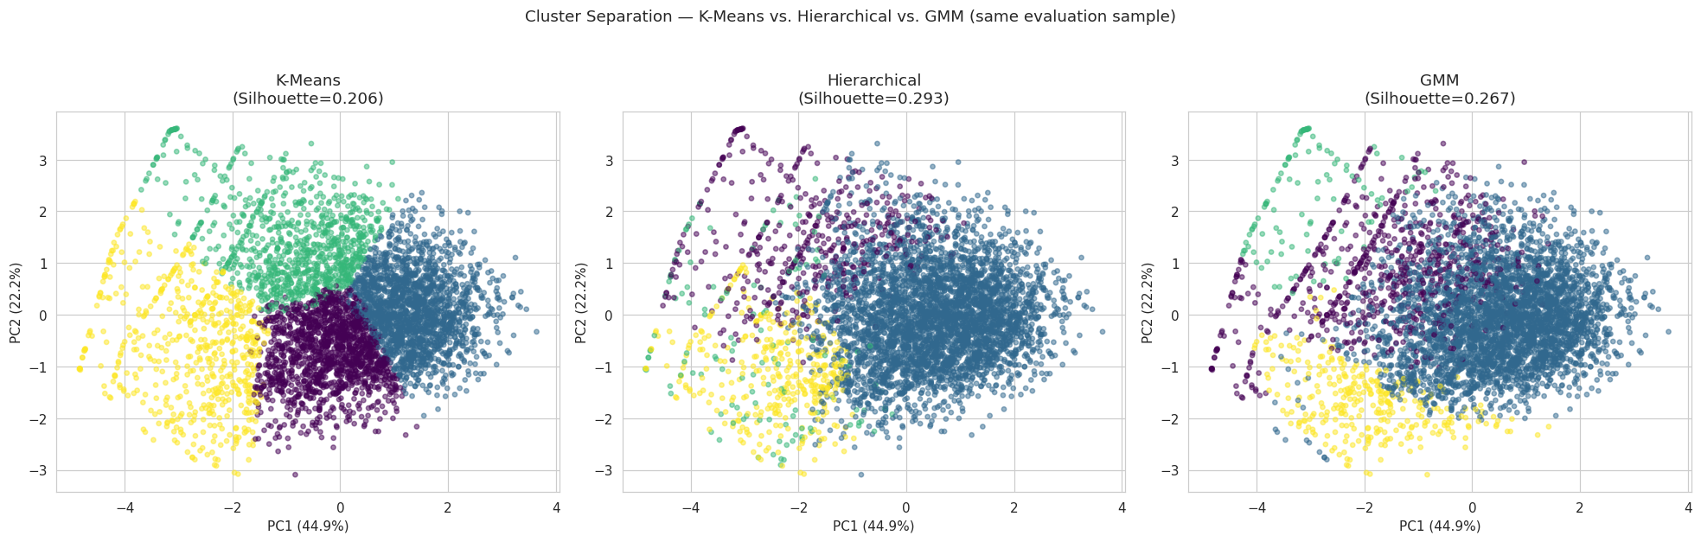
22/28
08 · RESULTS
Visual Cluster Comparison in PCA Space
Reading the scatter
Hierarchical clusters appear visibly more compact and better separated than K-Means or GMM. This tighter partition in PCA space corresponds directly to its superior Silhouette score — cohesion within clusters and clear distance between them.
11 / 14
Advanced Data Mining — Aug 4, 2026

Slide 23
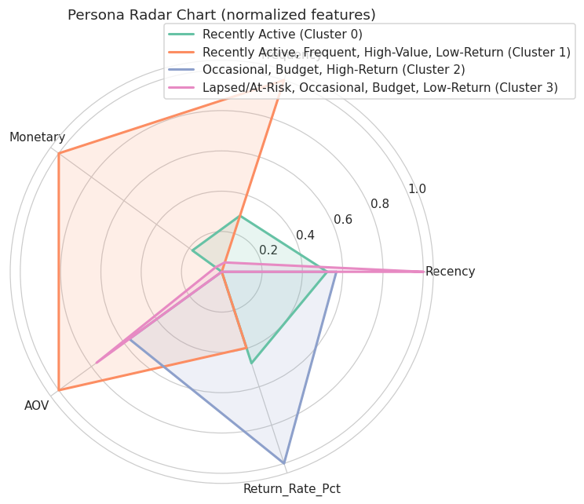
23/27
09 · OUTCOME
Best Model & Customer Personas
Four behavioural personas from Hierarchical Clustering.
Recently Active, Frequent, High-Value
40,181 · 81%
RECENCY
FREQ
MONETARY
RETURN %
207d
5.7
$15,559
40%
Lapsed / At-Risk, Occasional
4,593 · 9%
RECENCY
FREQ
MONETARY
RETURN %
491d
2.3
$7,643
36%
Recently Active, Budget, Low-Return
3,629 · 7%
RECENCY
FREQ
MONETARY
RETURN %
404d
2.7
$4,318
33%
Occasional, Budget, High-Return
1,258 · 3%
RECENCY
FREQ
MONETARY
RETURN %
475d
2.1
$4,294
97%
→ The 3% high-return segment may indicate return fraud or persistent product mismatch — a targeted intervention opportunity.

Slide 24
24/27
10 · REFLECTION
Why Hierarchical Won & Challenges Faced
WHY HIERARCHICAL WON
CHALLENGES FACED
Best cohesion, best separation, matching structure.
Trade-offs, caveats, honest limitations.
01
Highest Silhouette Score — the strongest cohesion-versus-separation reading of the three.
Scalability
O(n²) memory forced Hierarchical onto a 4,000-customer sample, reducing comparison fairness on absolute metrics.
02
Complete linkage produced compact, balanced clusters well-matched to RFM data shape.
Deployment
03
Convergent k = 4 cluster count corroborated by K-Means and GMM independently.
Hierarchical does not predict for new customers — required a surrogate k-NN model to score incoming users.
Preprocessing
RFM preprocessing (log, cap, standardize) was critical due to skew and outliers.
Modest scores
Silhouettes of 0.20–0.29 reflect natural overlap in real customer behaviour, not weakness of method.
13 / 14
Advanced Data Mining — Aug 4, 2026

Slide 25
25/27
10 · REFLECTION
Future Plan after this project
Model Deployment & Monitoring
Business Activation & Marketing Strategy
Advanced Modeling & Future Iterations
Production Integration: Deploy the final model via API/pipeline to dynamically segment incoming users.
Drift Monitoring: Continuously track cluster stability (DB, CH metrics) to detect shifting behaviors and data drift.
Personalized Campaigns: Tailor messaging, dynamic recommendations, and promotions based on cluster personas.
Product Alignment: Adapt features and onboarding flows to match segment-specific behaviors.
Classifier Pipeline: Train an XGBoost/Random Forest model on cluster labels to score new users immediately.
Dynamic Modeling: Upgrade static RFM to time-series models (RNNs/Markov chains) for tracking customer lifecycle shifts.
A/B Testing: Validate ROI and conversion lift by testing segment-targeted strategies against baselines

Slide 26

25/26
Demo of ML

Slide 27

26/26
Questions??

